Slide 1
Chapter 2: Operating System Structures

Slide 2
Chapter 2: System Structures
Operating System Services
User Operating System Interface
System Calls
Types of System Calls
System Programs
Operating System Design and Implementation
Operating System Structure
Operating System Debugging
Operating System Generation
System Boot

Slide 3
Objectives
To describe the services an operating system provides to users, processes, and other systems
To discuss the various ways of structuring an operating system
To explain how operating systems are installed and customized and how they boot

Slide 4

A View of Operating System Services

Slide 5
Operating System Services
➢ Program execution: OS must be able to load, run and terminate the programs.
➢ I/O operations: OS is responsible for transferring data to and from I/O devices.
➢ File-system manipulation: Programs need to read, write, delete and search files and directories.
➢ Communications: Processes exchange information between computers over a network.
➢ Error detection: OS to be aware of errors that may occur and take actions that handle them.
➢ Resource allocation: When multiple jobs running concurrently, resources are allocated to each of them.
➢ Accounting: Keep track of which users use how much and what kindsof computer resources.
➢ Protection and security: Ensuring that all access to system resources is controlled and provide authentication.

Slide 6
System Calls
Programming interface to the services provided by the OS
Typically written in a high-level language (C or C++)
Mostly accessed by programs via a high-level Application Programming Interface (API) rather than direct system call use
API: Set of functions available to an application including the parameters that are passed to each function and the return values the programmer can expect.
• Most common APIs are:
– Win32 for Windows systems
– POSIX API for POSIX-based systems (UNIX, Linux and MacOS X)
– Java API for Java virtual machine(JVM).

Slide 7
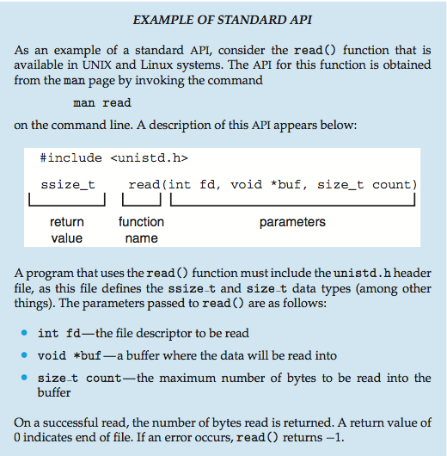
Example of Standard API

Slide 8
System Call Implementation
Typically, a number associated with each system call
  System-call interface maintains a table indexed according to these numbers
The system call interface invokes the intended system call in OS kernel and returns status of the system call and any return values
The caller need know nothing about how the system call is implemented
  Just needs to obey API and understand what OS will do as a result call
  Most details of OS interface hidden from programmer by API
    Managed by run-time support library (set of functions built into libraries included with compiler)

Slide 9

API – System Call – OS Relationship

Slide 10
System Call Parameter Passing
Often, more information is required than simply identity of desired system call
  Exact type and amount of information vary according to OS and call
Three general methods used to pass parameters to the OS
  Simplest: pass the parameters in registers
    In some cases, may be more parameters than registers
  Parameters stored in a block, or table, in memory, and address of block passed as a parameter in a register
    This approach taken by Linux and Solaris
  Parameters placed, or pushed, onto the stack by the program and popped off the stack by the operating system
  Block and stack methods do not limit the number or length of parameters being passed

Slide 11

Parameter Passing via Table

Slide 12

Standard C Library Example
C program invoking printf() library call, which calls write() system call

Slide 13


Example of single and multi-tasking
At system startup (b) running a program
MS-DOS
FreeBSD

Slide 14
Operating System Structure
1- Simple Structure MS-DOS
2- Layered Approach
3- Microkernels Mach
4- Modules
5- Hybrid Systems

Slide 15

Simple Structure
I.e. MS-DOS – written to provide the most functionality in the least space
  Not divided into modules
  Although MS-DOS has some structure, its interfaces and levels of functionality are not well separated
  Advantages:
  Simple and easy to implement
  Disadvantages:
– It does not break the system into subsystems.
– No distinction between user and kernel.
– Allow direct access to H.W

Slide 16
UNIX System Structure
UNIX – limited by hardware functionality, the original UNIX operating system had limited structuring. The UNIX OS consists of two separable parts
  Systems programs
  The kernel
    Consists of everything below the system-call interface and above the physical hardware
    Provides the file system, CPU scheduling, memory management, and other operating-system functions; a large number of functions for one level
    This kind of structure is called monolithic
    Advantages:
    1- Higher performance
    2-Add some protection
    Disadvantages:
    1-Very complex to maintain later

Slide 17

Traditional UNIX System Structure
Beyond simple but not fully layered

Slide 18

Layered Approach
The operating system is divided into a number of layers (levels), each built on top of lower layers. The bottom layer (layer 0), is the hardware; the highest (layer N) is the user interface.
With, modularityنمطيه layers are selected such that each uses functions (operations) and services of only lower-level layers
Advantages:
– Allows each layer to be developed and debugged independently.
– Developed and debugged independently "if error found in layer, the error must be in that layer".
• Disadvantage:
– What order in which to place the layers.
– Less efficient.

Slide 19
Microkernel System Structure
Moves as much from the kernel into user space
Mach example of microkernel Windows NT v1
  Mac OS X kernel (Darwin) partly based on Mach
Communication takes place between user modules using message passing
Benefits:
  Easier to extend a microkernel
  Easier to port the operating system to new architectures
  More reliable (less code is running in kernel mode)
  More secure
Detriments: Disadvantages
  Performance overhead of user space to kernel space communication
  That’s why, Windows XP designed almost as monolithic again

Slide 20

Microkernel System Structure

Slide 21
Modules
Most modern operating systems implement loadable kernel modules
  Uses object-oriented approach
  Each core component is separate
  Each talks to the others over known interfaces
  Each is loadable as needed within the kernel
Overall, similar to layers but with more flexible
The kernel has a set of core services and links additional services via modules,either at boot time or during run time.
Linking services dynamically add new features to the kernel and loaded as
needed.
Modules do not need to invoke message passing.
Similar to the microkernel approach but it is more efficient.

Slide 22

Modules
• Advantages:
– Kernel is small and efficient as microkernel.
– Modules easy linked to any other module (no message passing).
• Example: Solaris

Slide 23
Hybrid Systems
Most modern operating systems actually not one pure model
  Hybrid combines multiple approaches to address performance, security, usability needs
Examples:
– Mac OS X
– iOS
– Android

Slide 24
End of Chapter 2

